Slide 1
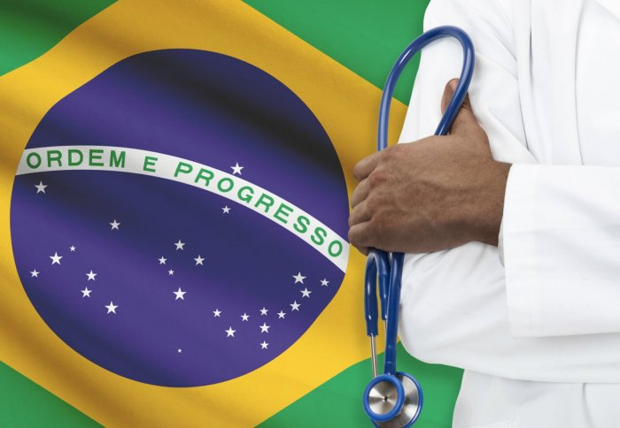
Evaluating Medical No-Shows in Brazil
Kasie Wong & Michael Dowlin
Rice Data Analytics Bootcamp
April 2020

Slide 2
Inspiration
The Brazilian government began rolling out free primary healthcare under the Family Health Strategy (FHS) in the 1990s. ¹
Today, around 70% of the Brazilian population is covered by FHS, which has become the main platform for achieving universal health coverage in the country. ¹
Although universal health care exists, the public sector struggles to fund medical care and services for Brazil’s 210 million people. ²
Identifying the factors that contribute to individuals not showing up for their medical appointments will greatly help public clinics better optimize their operational efficiencies and assist the public health ministry in conducting more focused outreach programs to ensure proper medical care for all its citizens.

Slide 3

Source Data
Brazil Medical Appointment No Shows:
110K+ Appointment records from April 2016 – June 2016
Brazil 2010 Census:
Median Monthly Nominal Income by Neighborhood

Slide 4
Initial Data Findings

Slide 5
Initial Data Findings

Slide 6
Initial Data Findings

Slide 7
Initial Data Findings

Slide 8
Attempting Feature Selection Using Pearson’s Correlation Method
Used correlation matrix to determine which features were most statistically relevant to being a no-show
Pearson’s correlation coefficient measures linear correlation between each feature and no-show variable between 0 and 1.
Statistical relevance would indicate a correlation absolute value >0.5
Unfortunately, all features in the matrix had a weak (<0.5) correlation to no-show variable
Needed to find another way to analyze relevant features for analysis

Slide 9
Consultation with Latin America Health Specialist
Consulted with Andrea Ulrich, International development consultant who specializes in the Latin American public health sector
Ulrich said that based on prior research, strong indicators for individuals not showing up to medical appointments are:
Forgetfulness (lack of reminders)
Appointment time of day
Poverty (Working class individuals tend to have less flexible working schedules to accommodate inconvenient appointment times)
Lack of public transportation/infrastructure to clinic location (majority of Brazilians use public buses/vans)
Could not find public transportation rankings by Neighborhood, but Ulrich advised using Median Income of Neighborhood instead as proxy for classification. There is a strong correlation between median neighborhood income and its public transportation infrastructure
Ulrich also advised excluding data for poor women who received SMS reminders. She said that the majority of Brazilian families only have one mobile phone per household and it is often carried by a male family head. Thus, despite receiving SMS reminders, women may not actually receive the notifications.
Andrea Ulrich,
Deputy Director of Operations
Development Gateway

Slide 10
Brazil 2010 Census Data Findings

Slide 11
Selecting Test Features & Binning Methodology
Used correlation matrix to determine which features were most statistically relevant to being a no-show
Pearson’s correlation coefficient measures linear correlation between each feature and no-show variable between 0 and 1.
Statistical relevance would indicate a correlation absolute value >0.5
Unfortunately, all features in the matrix had a weak (<0.5) correlation to no-show variable
Needed to find another way to analyze relevant features for analysis

Slide 12
Testing Logistic Regression Classification Model - Original
Original Dataset Run Results Dataset as is with 110K+ Appointments
Accuracy | 0.7979443
Precision | 0.3
Recall | 0.0005377
MCC | 0.0046493
Training Data Score: 0.7982506936904331
Testing Data Score: 0.7979443378813651

Slide 13
Testing Logistic Regression Classification Model – Excl. Poor women w/ SMS (Post Consultation)
Post Consultation Run Results Dataset as is with ~94K Appointments
Accuracy | 0.81482
Precision | 0.8
Recall | 0.00091954
MCC | 0.023091356
Training Data Score: 0.8147080540724753
Testing Data Score: 0.8148242811501597

Slide 14
Testing Logistic Regression Classification Model – Excl. Poor women w/ SMS (Post Consultation w/ GridsearchCV parameter tuning)
Post Consultation w/ tuning Run Results Dataset as is with ~94K Appointments
Accuracy | 0.81469649
Precision | 0
Recall | 0
MCC | 0
Training Data Score: 0.8147506531864137
Testing Data Score: 0.8146964856230032

Slide 15
Testing Random Forest Classification Model - Original
Original Dataset Run Results Dataset as is with 110K+ Appointments
Accuracy | 0.792986
Precision | 0.3960739
Recall | 0.061913
MCC | 0.087866
Training Data Score: 0.8101097840511521
Testing Data Score: 0.792986138757193

Slide 16
Testing Random Forest Classification Model – Excl. Poor women w/ SMS (Post Consultation)
Post Consultation Run Results Dataset as is with ~94K Appointments
Accuracy | 0.8074547
Precision | 0.38961
Recall | 0.061827
MCC | 0.091247
Training Data Score: 0.8267494036124049
Testing Data Score: 0.807454739084132

Slide 17
Testing Random Forest Classification Model – Excl. Poor women w/ SMS (Post Consultation w/ GridsearchCV parameter tuning)
Post Consultation w/ tuning Run Results Dataset as is with ~94K Appointments
Accuracy | 0.81252396
Precision | 0.55556
Recall | 0.00680735
MCC | 0.04522886
Training Data Score: 0.8174059979552425
Testing Data Score: 0.8125239616613419

Slide 18
Comparing Random Forest vs Logistic Regression Results
Unfortunately, based on the low Matthew’s Correlation Coefficients (MCC) for all models run, all these models would perform poorly at predicting whether future patients would be no-shows.
However, according to several forensic studies, ROC area (AUC) is a good diagnostic for determining the validity of potential influencing factors for predicting future behavior. AUC values of 0.70 and higher are considered as having strong effects.
As our best models using both random forest and logistic regression classification methods have AUC’s of ~ 0.747, this indicates that they potential for indicating feature relevancies amongst each other.

Slide 19
References
¹ https://www.imperial.ac.uk/news/179735/free-universal-healthcare-reduces-health-inequality/
²https://www.ifc.org/wps/wcm/connect/news_ext_content/ifc_external_corporate_site/news+and+events/news/impact-stories/better-managed-brazilian-hospitals
³ https://www.kaggle.com/joniarroba/noshowappointments
⁴ https://www.ibge.gov.br/
⁵https://www.researchgate.net/publication/7511660_Rice_ME_Harris_GTComparing_effect_sizes_in_follow-up_studies_ROC_Area_Cohen's_d_and_r_Law_Hum_Behav_29_615-620

